Slide 1
MARKETWISE
ROUND 2
Team Tangerine

Slide 2
01
Event Recommendation and Personalization

Slide 3
01
02
03
Model Development
Data Processing and EDA
Real Time customization and Feedback

Slide 4
Data Processsing
Feature Engineering
Removing Redundancies
Removing Duplicates and replacing null values
Data Processing and EDA

Slide 5
FINDINGS!
Data Processing and EDA
12 Categories were offered by the Exhibitors
Mumbai and Pune are the leading cities as per number of exhibitors
Most of the Exhibitors as well as the Visitors are from India
Most of the Visitors were from Maharashtra and South Indian States
Maharashtra and Gujarat are the leading states as per number of exhibitors

Slide 6
Process of Model Development
Using Tfidf Vectorizer
Cosine similarity, Pearson collinearity, Euclidean distance
After careful deliberation we selected cosine similarity
Model Development
Tokenization
Exploring our options
Selection

Slide 7
Implemented a Feed-back System for further insights to refine the model
Real Time customization and Feedback
Implemented a Real Time recommendation cum attendance System
Made a feature to continuously refine the model upon attendance

Slide 8
02
AI-Powered Lead Capture and Connection Optimization

Slide 9
NLP Based Lead generation
Data Collection
NLP Integration
Testing and Refinement
Deployment and Monitoring

Slide 10
Benefits to the Stakeholders
Improved Lead Qualification
Personalized Communication
Enhanced Segmentation and Targeting
Data-Driven Insights and Decision Making

Slide 11
03
Engagement Enhancement Strategies and Campaign Optimization

Slide 12
01
02
03
Preparing, Processing and exploring the data
Model Selection and Tuning
Real Time customization and Feedback

Slide 13
Steps to process data
Preparing, Processing and exploring the data
Data generation
Generated a Dataset with 8 columns
Event_ID, Event_Name
Event_Type, Event_Date
Location, Ticket_Price
Weather_Condition, Attendance_Count
Handle the missing values
Remove the duplicates and outliers
Correct the data types
Feature Engineering

Slide 14
FINDINGS!
Preparing, Processing and exploring the data
Locations can affect the attendance count
Weather conditions affect the attendance count
Ticket Pricing Strategy widely influences the Attendance
Conference is the most popular event
Attendance is the highest on weekends

Slide 15
WHAT THEY SAY ABOUT US?
Various regressor models like linear, gradientboost, catboost, random forest, neural networks etc.
Using Grid Search
Tuning our lambda
Selecting model based on Cross validation MSE
Model Selection and Tuning
Exploring our options
Hyperparameter tuning
Regularization
Selection

Slide 16
Implemented a Feed-back System for further insights to refine the model
Real Time customization and Feedback
Implemented a Real Time attendance System… Will be incorporating an NFC based system
Made a feature to continuously refine the model

Slide 17
04
Sponsorship ROI Analysis

Slide 18
01
02
03
Preparing, Processing and exploring the data
Model Selection and Tuning
Real Time customization

Slide 19
Steps to process data
Preparing, Processing and exploring the data
Data generation
Generated a Dataset with 16 columns
Sponsor ID, Sponsor Name, Industry, Company Size
Package Type, Sponsorship Amount, Duration (months), Marketing Activities
Event ID, Event Name, Event Type, Event Date
Event Month, Attendee Demographics, ROI Metrics, Feedback
Handle the missing values
Remove the duplicates and outliers
Correct the data types
Feature Engineering

Slide 20
FINDINGS!
Preparing, Processing and exploring the data
Locations can affect the attendance count
Weather conditions affect the attendance count
Ticket Pricing Strategy widely influences the Attendance
Conference is the most popular event
Attendance is the highest on weekends

Slide 21
Process of model development
Various regressor models like linear, gradientboost, catboost, random forest, neural networks etc.
Using Grid Search
Tuning our lambda
Selecting model based on Cross validation MSE
Model Selection and Tuning
Exploring our options
Hyperparameter tuning
Regularization
Selection

Slide 22
Implemented a Feed-back System for further insights to refine the model
Real Time customization and Feedback
Implemented a Real Time ROAS Prediction System
Made a feature to continuously refine the model by taking the ground truth after the event

Slide 23
Website UI

Slide 24
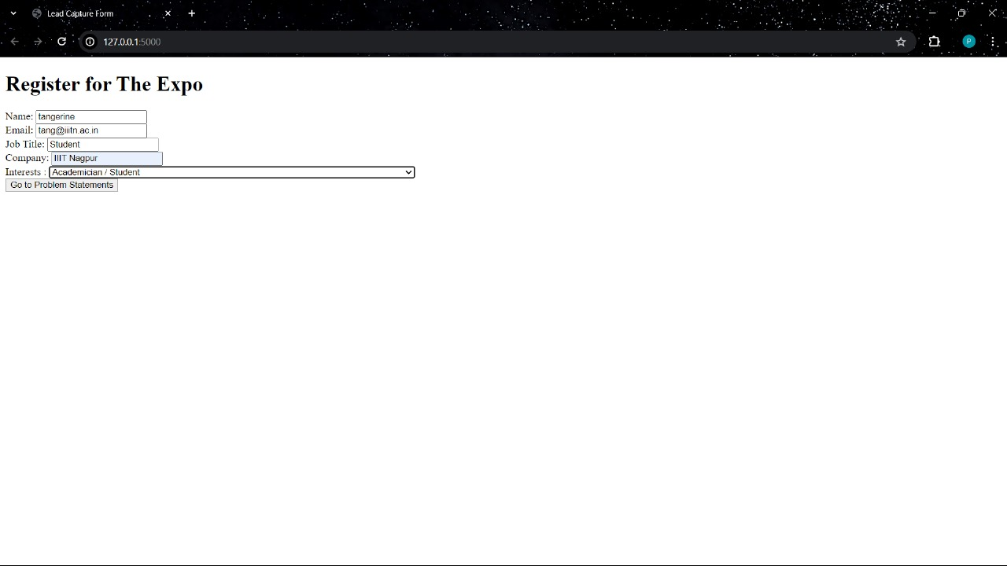
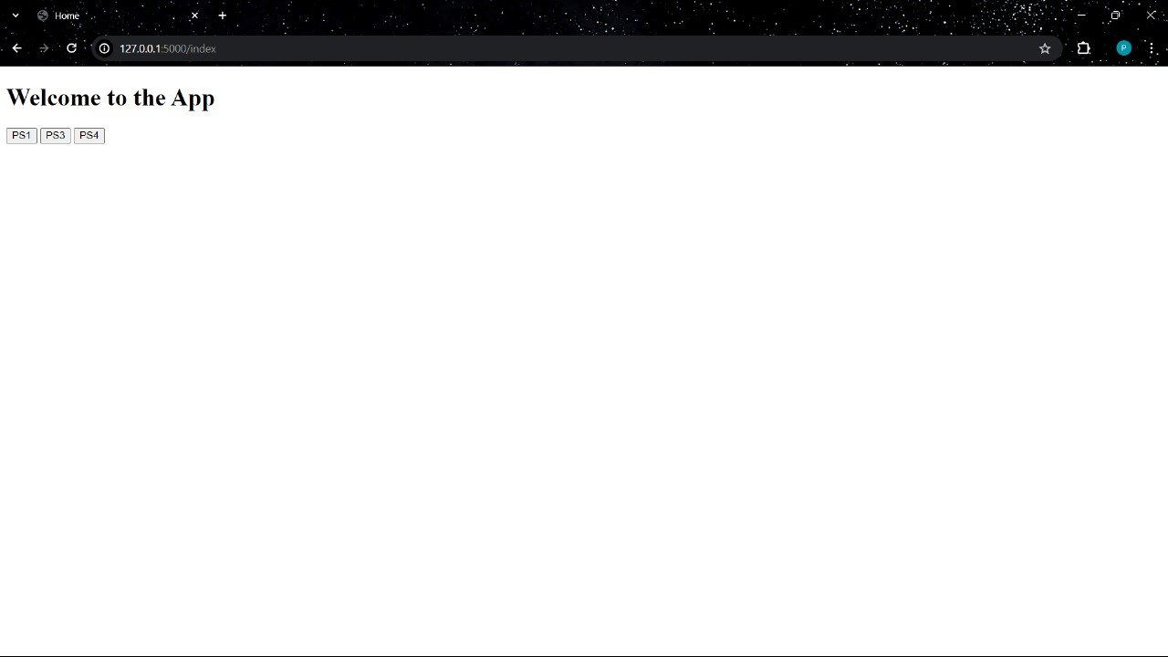

Slide 25
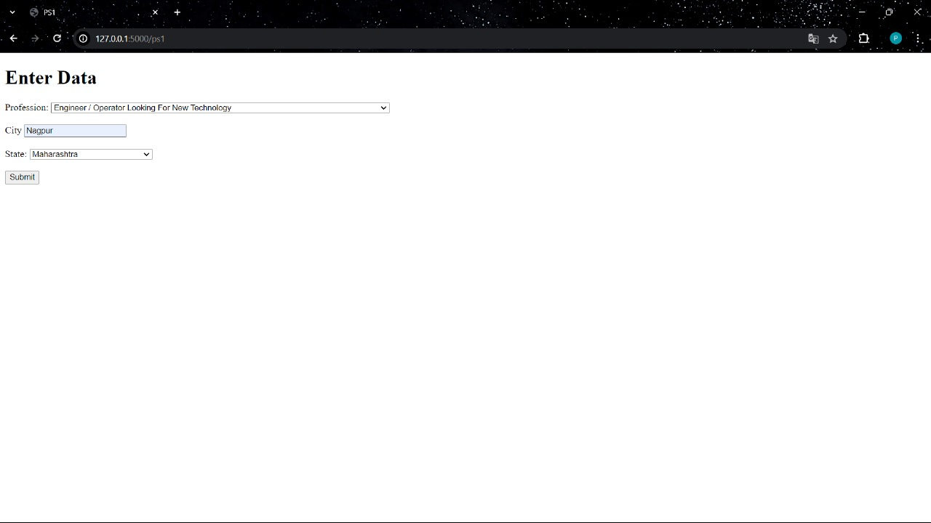
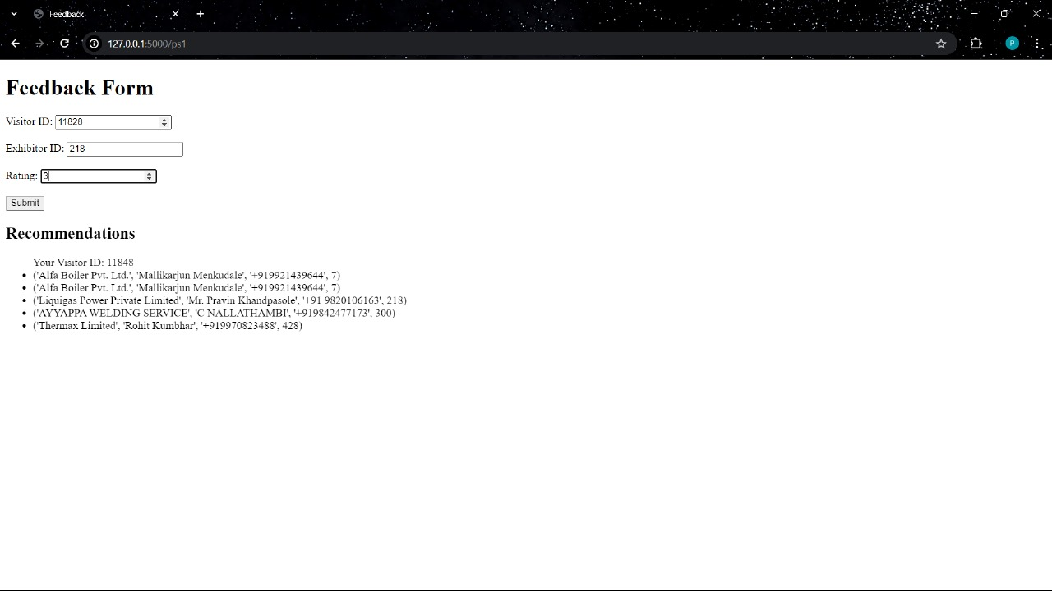

Slide 26
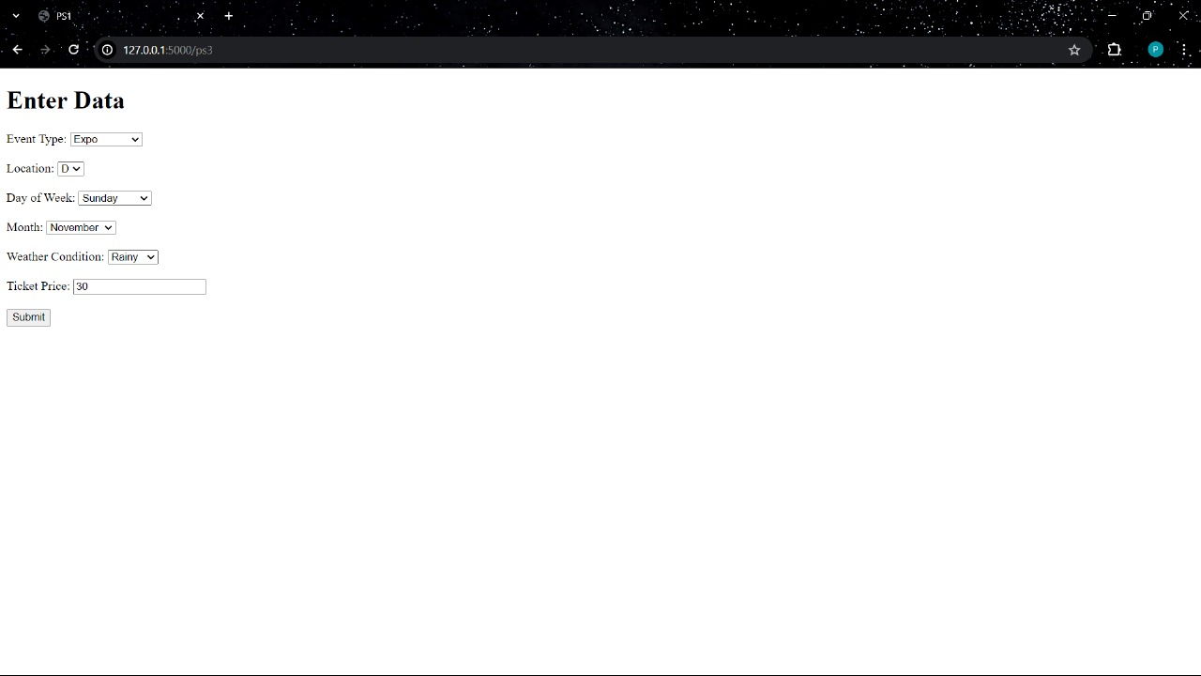
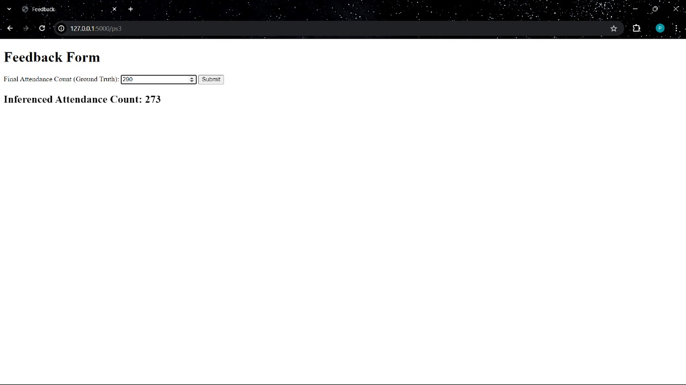

Slide 27
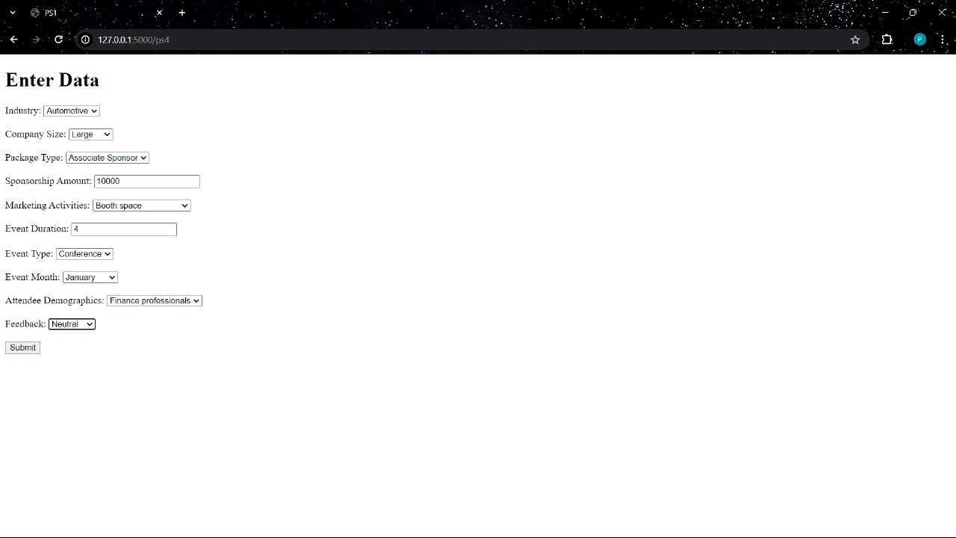
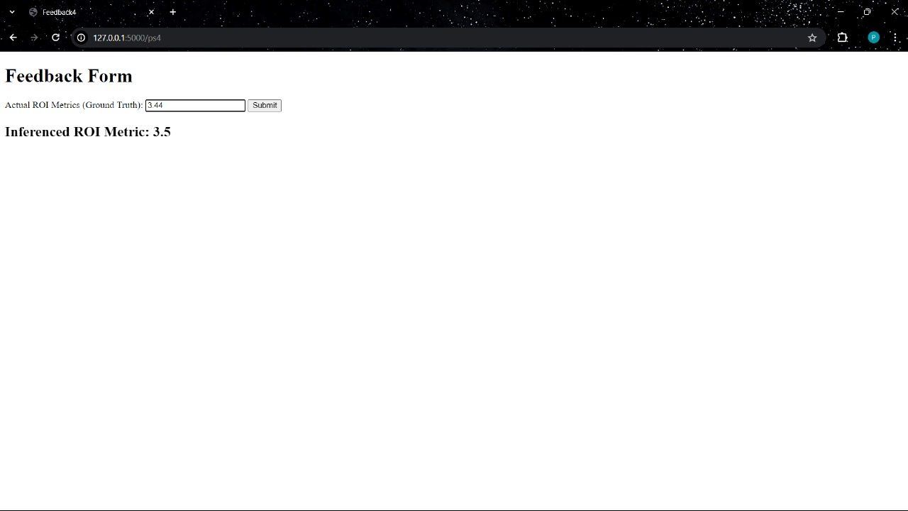

Slide 28
